Slide 1
INTELLIGENT MANHOLE MONITORING SYSTEM USING DATA MINING
TEAM GUIDE :
TEAM MEMBERS :
Mrs. D. ELAVARASI M.E.,Ph.D*.,
HEAD OF THE DEPARTMENT
I. SATHIYA PRIYA - 911719104060
A. REEMA HAJRA - 911719104056
M. SELCIA - 911719104062

Slide 2
ABSTRACT
Drainage is the framework or procedure by which water, sewage or different fluids are depleted from a spot and to keep up the best possible capacity of waste, its condition ought to be checked consistently. In any case, physically it is exceptionally hard to screen all regions that a human can't reach. This impacts the blockage of underground funnels and floods of water causing the medical issue. additionally abstains from spreading of contamination because of mosquitoes and gives perfect and sound conditions just as controls the sickness, for example, jungle fever, dengue, looseness of the bowels, and so forth. The framework diminishes the mishap brought about by an uncovered sewer vent.

Slide 3
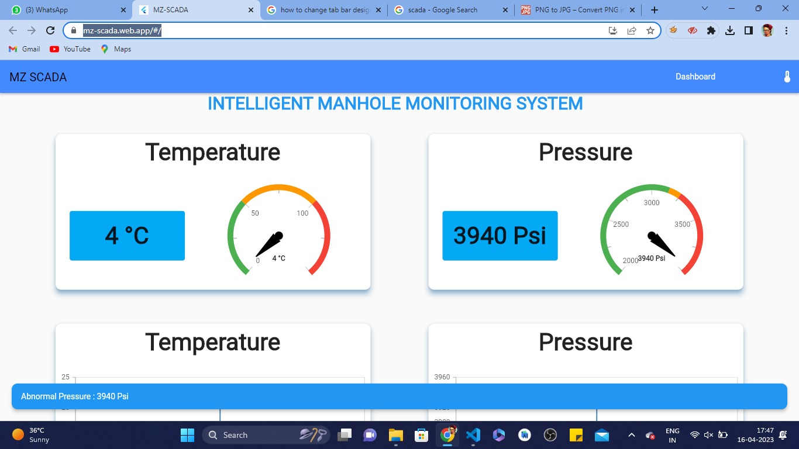
EXPERIMENTAL RESULTS

Slide 4
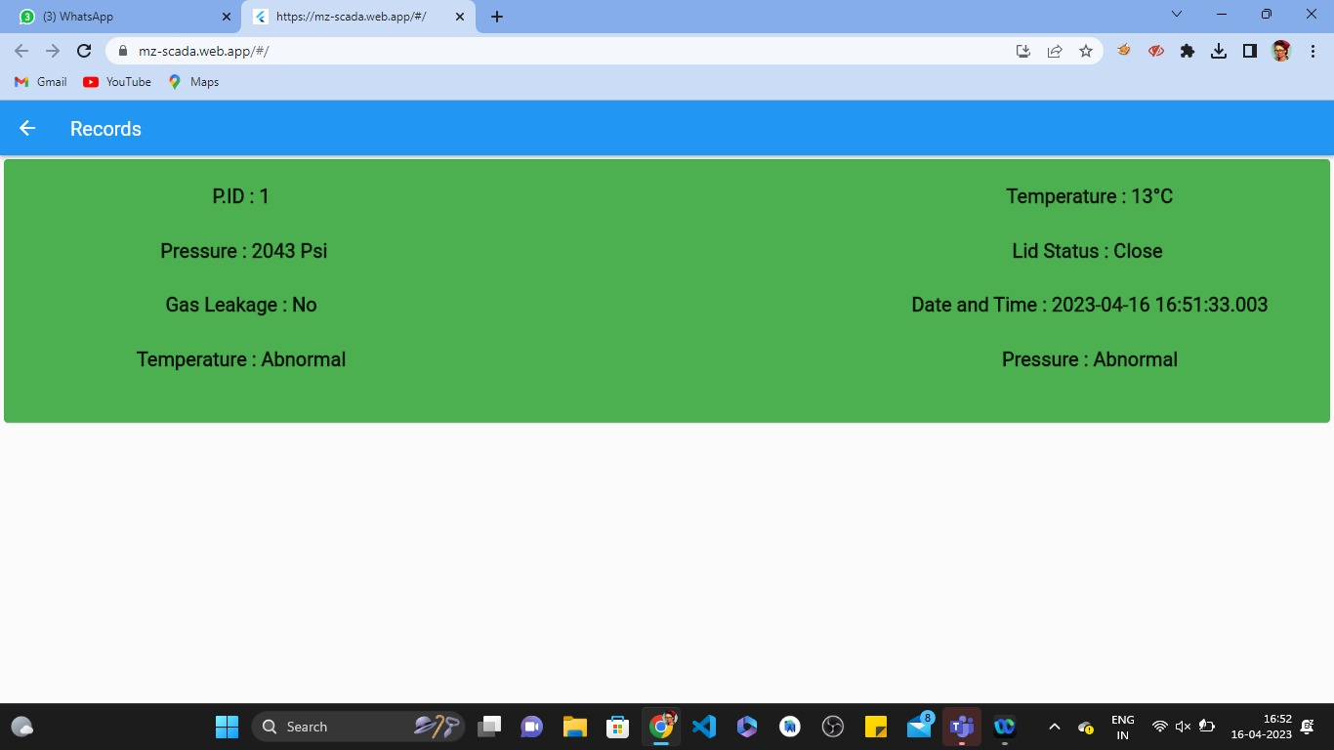
EXPERIMENTAL RESULTS

Slide 5
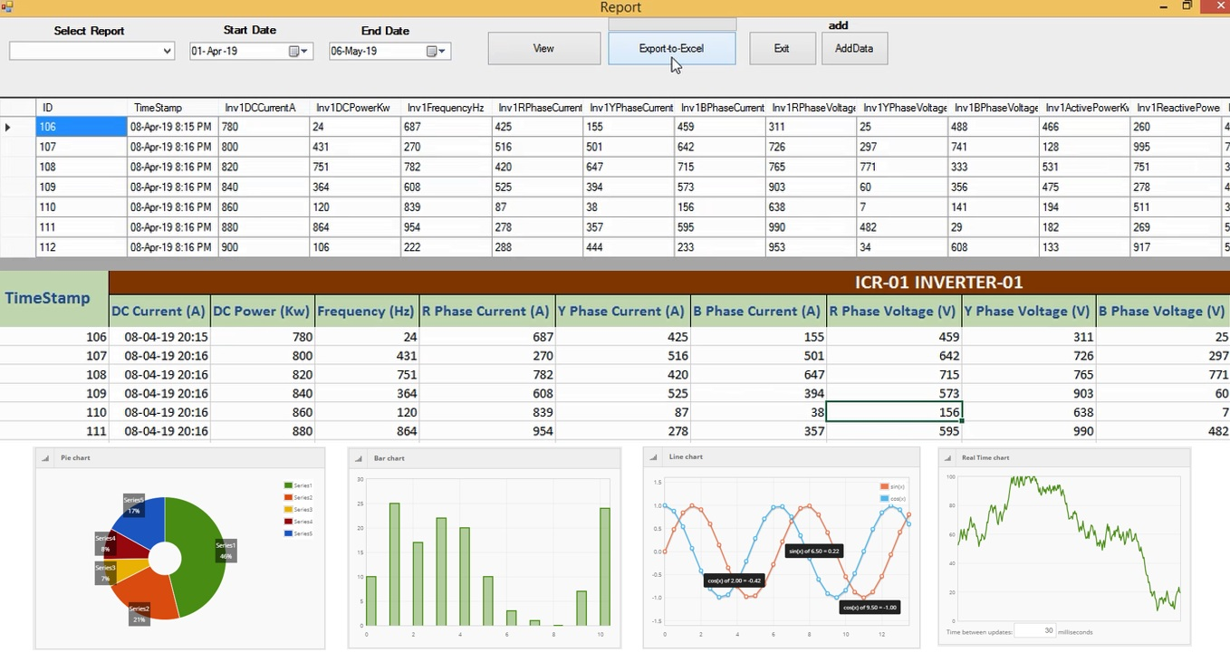
PERFORMANCE EVALUATION

Slide 6
REFERENCES
Lazarescu, M.T., "Design of a WSN Platform for Long- Term Environmental
Monitoring for IoT Applications," Emerging and Selected Topics in Circuits and
Systems, IEEE Journal on , vol.3, no.1, pp.45,54, March 2013
Kelly, S.D.T.; Suryadevara, N.K.; Mukhopadhyay, S.C., "Towards the
Implementation of IoT for Environmental Condition Monitoring in Homes,"
Sensors Journal, IEEE, vol.13, no.10, pp.3846, 3853, Oct. 2013.
I. Akyildiz, W. Su, Y. Sankarasubramanian, E. Cayirci, “A Survey on Sensor
Networks”, IEEE Communications Magazines, August 2002.
A. OzanBicen and Ozgur B. Akan and V. CagriGungor, “Spectrum-Aware and
Cognitive Sensor Networks for Smart Grid Applications,” IEEE Communications
Magazine, No. 5pp. 158-165. 2012
J. Guevara, F. Barrero, E. Vargas, J. Becerra, S. Toral, “Environmental wireless
sensor network for road traffic applications,” IET Intell.Transp. Syst., Vol. 6, Iss.
2, pp. 177–186, 2012

Slide 7
CONTRIBUTION OF THE CANDIDATE
I. SATHIYA PRIYA - Coding ,Testing , and Implementation
A. REEMA HAJRA - Design , Case study and Documentation
M. SELCIA - Coding ,Testing , and Implementation

Slide 8
CODE IMPLEMENTATION
import 'package:flutter/material.dart’;
import 'dashboard.dart’;
import 'dashboard_phone.dart';class response extends StatefulWidget
{
const response({super.key});
@override State<response> createState() => _responseState();
}
class _responseState extends State<response>
{
@override Widget build(BuildContext context)
{
return LayoutBuilder(builder: (context, constraints)
{
if (constraints.maxWidth < 700)
{ return mobile(context);
}
// else if (constraints.maxWidth < 1250)
{
// return Desktop(context);
// }
else
{
return Desktop(context);
} });
}
Widget mobile(BuildContext context)
{ return pdash();
} Widget Desktop(BuildContext context)
{ return dash();
}
}

Slide 9
THANK YOU !!!

